Slide 1
Data Structures and Algorithms CS 213- Lecture 1
RK Shyamasundar

Slide 2
Broad Topics
Introduction to data structures,
Abstract data types, analysis of algorithms.
Creation and manipulation of data structures: arrays, matrices, sparse matrices, lists, stacks, queues, trees, heaps, hash tables, balanced trees, tries, graphs.
Algorithms for sorting and searching,
Depth-first and breadth-first search,
Paradigms:
The greedy method.
Divide-and-conquer.
Dynamic programming.
Backtracking.
Branch-and-bound.

Slide 3
Text Books
S. Sahni, Data Structures, Algorithms and Applications in C++,2nd edition, Universities Press,2005
T. Cormen, C. Leiserson, R. Rivest, C. Stein, Introduction to Algorithms, 2nd edition, Prentice-Hall India, 2001.

Slide 4
Organization
Lectures – Monday, Thursday: 330-500PM
Assignments + Quizes -- 30%
Plan is to give a set of problems after each (or a couple ) of lectures. One set is to be submitted before midsem (date will be announced later) and one before finals.
Quiz???
Mid Term – 30%
Final Exam – 40%
Attendance Necessary
Academic Honesty Policy:
http://www1.iitb.ac.in/newacadhome/rules.jsp

Slide 5
TAs
Deepali Mittal,
Mayukh,
Swatish,
Sanjana
153050016@iitb.ac.in 153050017@iitb.ac.in 153050025@iitb.ac.in 153050059@iitb.ac.in
Amit Goyal Rahul bisain

Slide 6
Tentative Agenda
Introduction
Role of Data structures
Concerns of program Construction
Analysis of Algorithms: Notations
Complexity Analysis forms
Recurrence Relations/Recursive Programs
Merge Sort, asymptotic analysis and performance measurement of programs.
Data representation methods and linear lists
Arrays, matrices, sparse matrices
Stacks.
Queues.
Hashing
LZW compression.
Binary trees, AVL Trees
Priority queues.
Tournament trees.
Search trees.
Graphs.
The greedy method.
Divide-and-conquer.
Dynamic programming.
Backtracking.
Branch-and-bound.

Slide 7
What is it about?
Data structures: Representation and manipulation of data.
Programs manipulate data.
Programs as data
How do we manipulate Data?

Slide 8
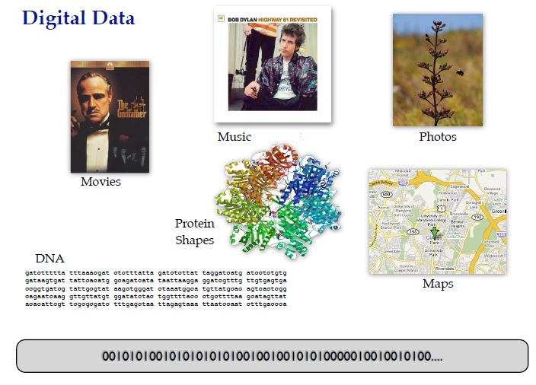

Slide 9
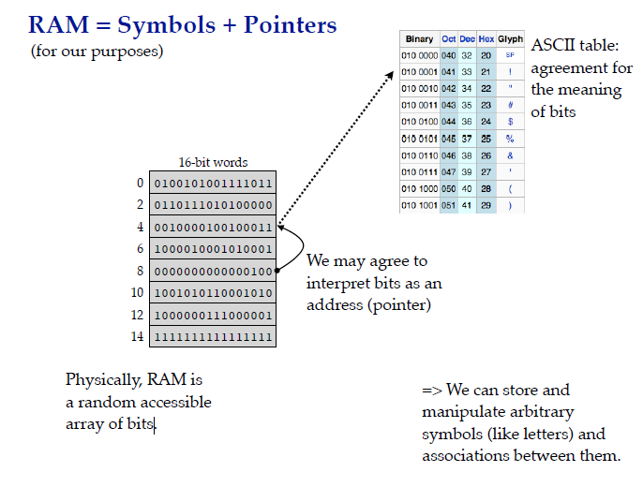

Slide 10
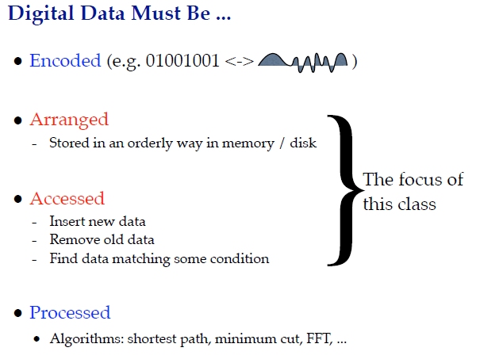

Slide 11
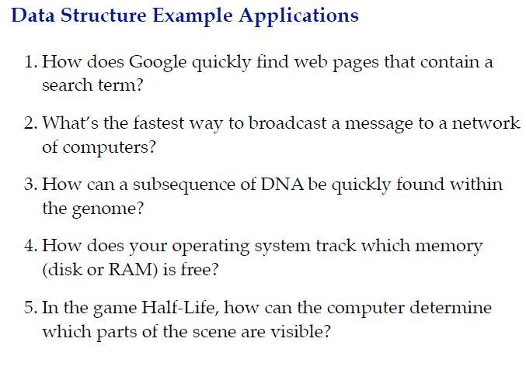

Slide 12
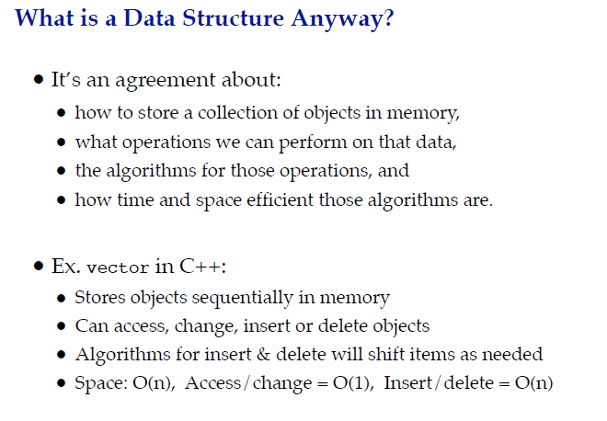

Slide 13
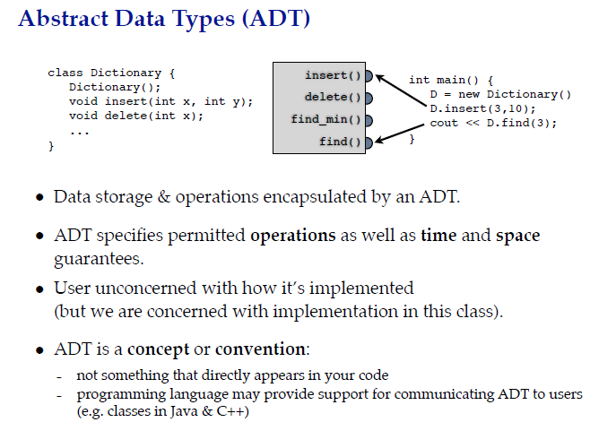

Slide 14
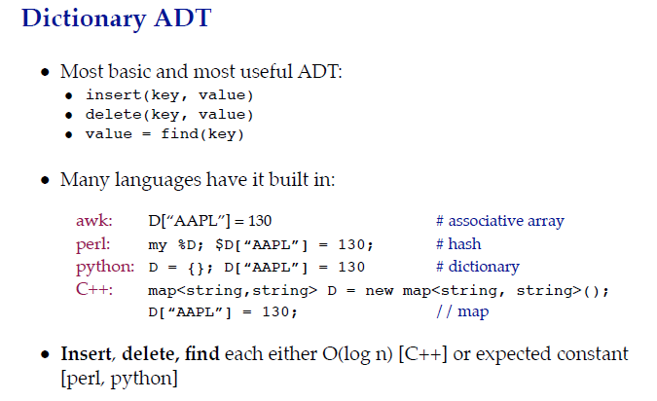

Slide 15
C++ STL
STL (Standard Template Library) is a powerful set of C++ template classes to provides general-purpose templatized classes and functions that implement many popular and commonly used algorithms and data structures like vectors, lists, queues, and stacks.

Slide 16
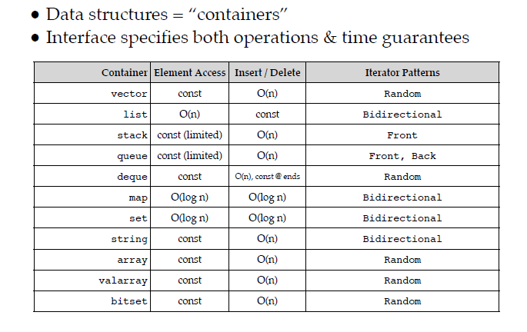
C++ STL

Slide 17
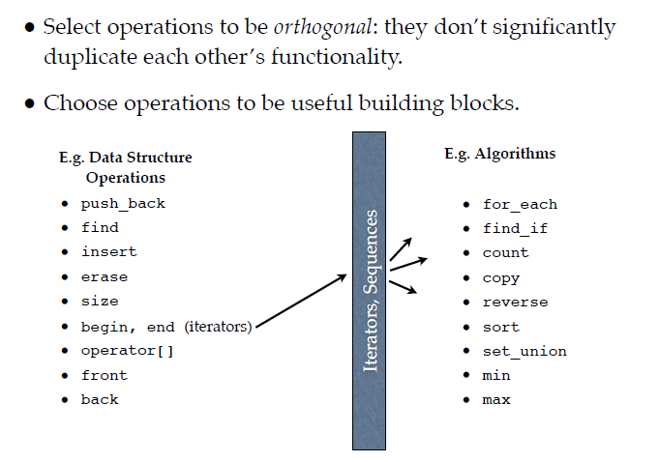
Some STL Operations

Slide 18
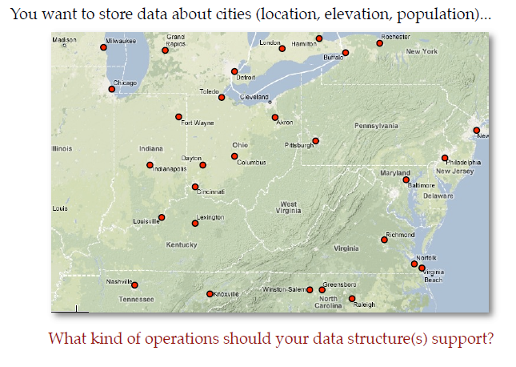
Consider Google Maps

Slide 19
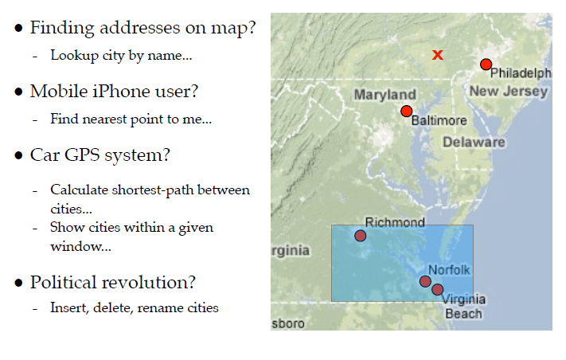
Operations to support these Operations

Slide 20
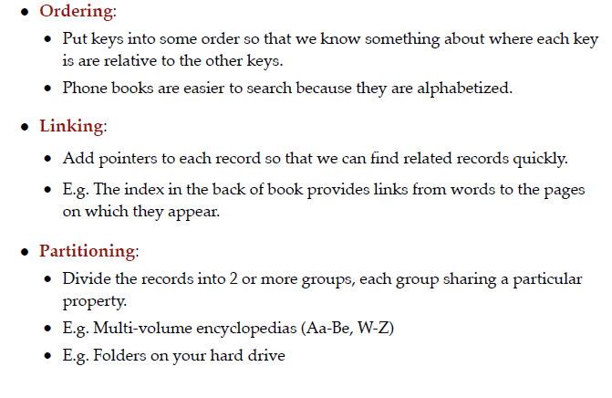
Data Organizing Principles

Slide 21
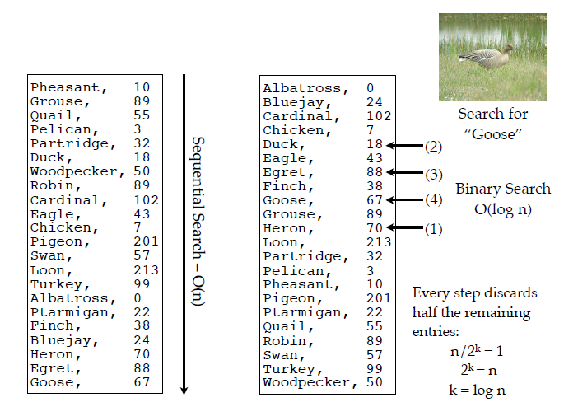
Ordering

Slide 22
Paradigms
Algorithms + Data Structures = Programs
Imperative Programs
Logics + Control = Programs
Logic Programs – Declarative Specifications
Example Finding a transitive closure of a program

Slide 23
Broad Coverage
Algorithm design methods needed to develop programs that do the data manipulation.
Study of data structures and algorithms: Crux of Computer Science.

Slide 24
Programs
Two Concerns
Correctness
Efficiency

Slide 25
Writing an convincing program
Three arrays
F[i], G[j], H[k] monotonically decreasing
Given that there exists a i,j, k such that F[i] = G[j] = H[k], write program computing the points of common intersection

Slide 26

A Simple Example

Slide 27

Permutation

Slide 28

Another Example

Slide 29

GCD

Slide 30
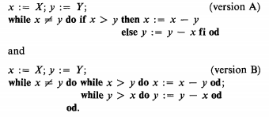
GCD (Classical versions)
What about computation of LCM?

Slide 31
Understanding Efficiency: Reachabilty Problem
Consider a directed graph and find for each node all the nodes that it can reach.
Algorithm?
-- data Structures

Slide 32
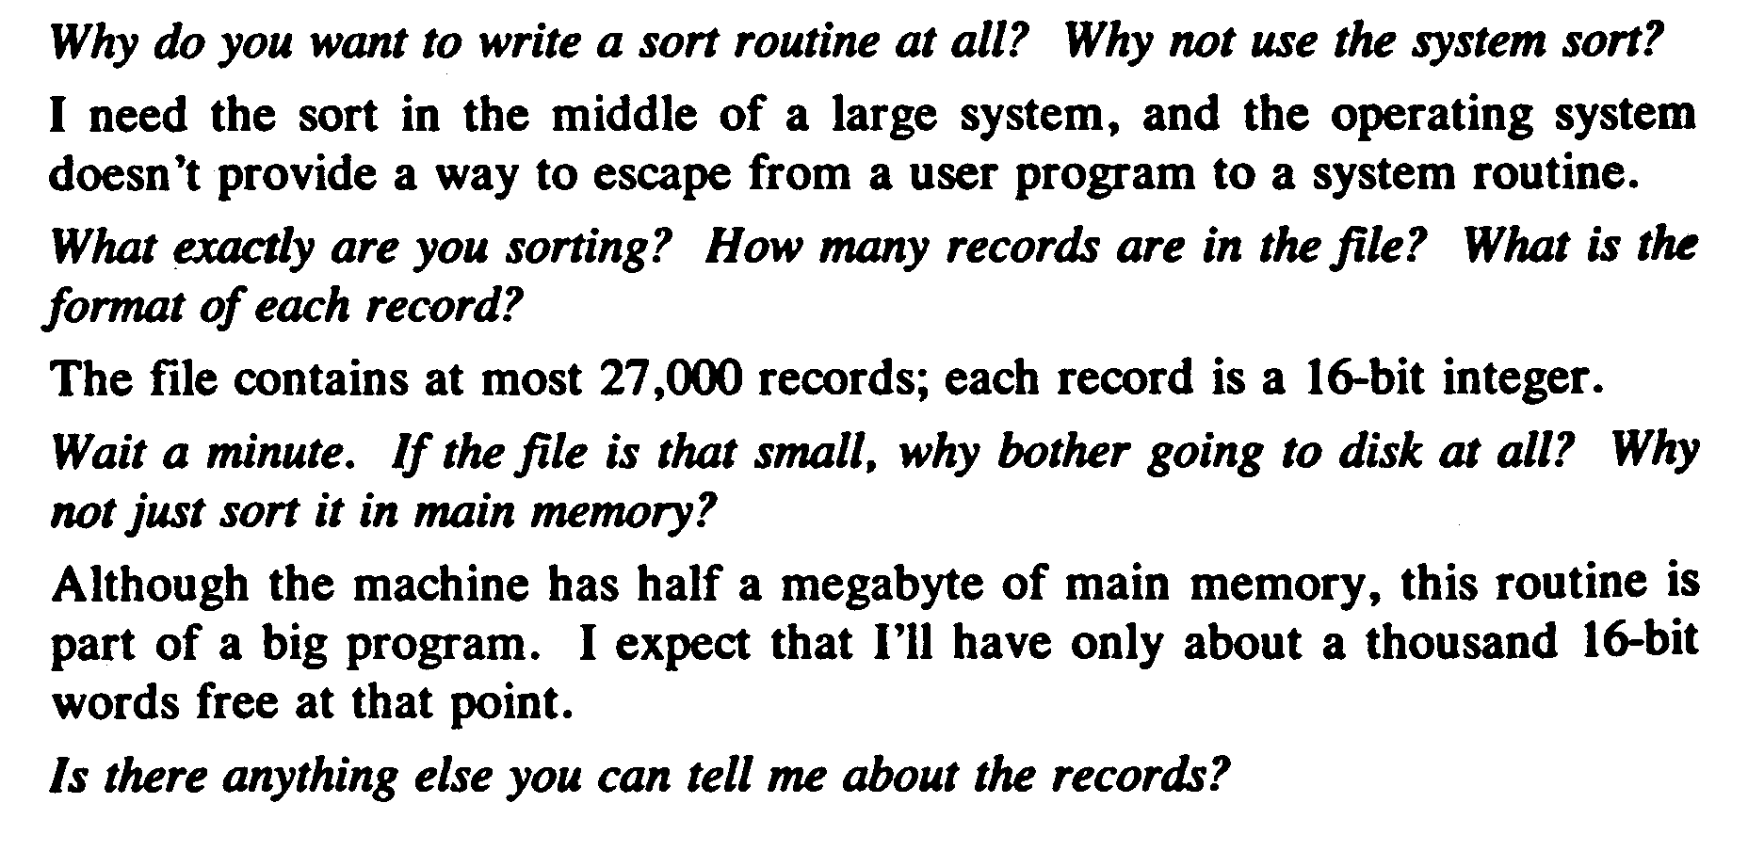
A user (customer) specifying a problem How do I sort on Disk? –Jon Bentley
Each one is an integer in the range 1..27000 and no integer appears more than once

Slide 33
Sorting
Rearrange a[0], a[1], …, a[n-1] into ascending order.
When completed,
a[0] <=a[1] <= … <= a[n-1]
8, 6, 9, 4, 3 => 3, 4, 6, 8, 9

Slide 34
Inserting an Element
Given a sorted list/sequence, insert a new element
Given 3, 6, 9, 14
Insert 5
Result 3, 5, 6, 9, 14

Slide 35
A Naïve Algorithm for Insertion
// insert t into a[0:i-1]
int j;
for (j = i - 1; j >= 0 && t < a[j]; j--)
a[j + 1] = a[j];
a[j + 1] = t;

Slide 36
Inserting an element in an ordered sequence
3, 6, 9, 14 insert 5
Compare new element (5) and last one
(14)
Shift 14 right to get 3, 6, 9, , 14
Shift 9 right to get 3, 6, , 9, 14
Shift 6 right to get 3, , 6, 9, 14
Insert 5 to get 3, 5, 6, 9, 14

Slide 37
Insertion Sort
Start with a sequence of size 1
Repeatedly insert remaining elements

Slide 38
Insertion sort
Sort 7, 3, 5, 6, 1
Start with 7 and insert 3 => 3, 7
Insert 5 => 3, 5, 7
Insert 6 => 3, 5, 6, 7
Insert 1 => 1, 3, 5, 6, 7

Slide 39
Insertion Sort
for (int i = 1; i < a.length; i++)
{// insert a[i] into a[0:i-1]
int t = a[i];
int j;
for (j = i - 1; j >= 0 && t < a[j]; j--)
a[j + 1] = a[j];
a[j + 1] = t;
}
How many comparisons are made?

Slide 40
Counting Methods
Worst case count = maximum count
1 + 2 + 3 + … + (n-1) = (n-1)n/2
Best case count = minimum count
Average count

Slide 41
Asymptotic Complexity of Insertion Sort
O(n2)
What does this mean?
Is O(n2) too much time?
Is the algorithm practical?

Slide 42
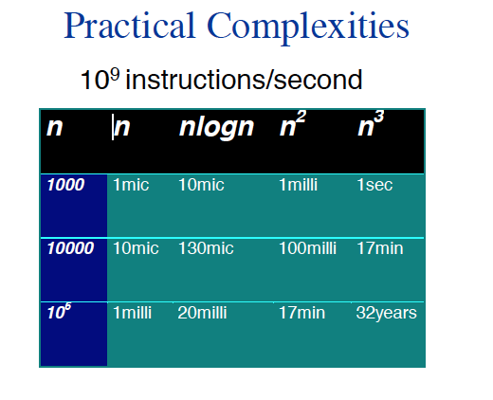

Slide 43
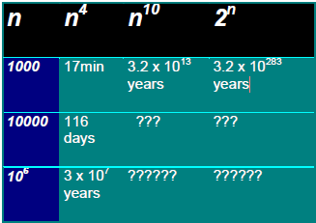
How practical is the algorithm?
10^9 instructions per second

Slide 44
Complexity of Algorithms
Time Complexity: Running time of the program as a function of the size of input
Space Complexity: Amount of computer memory required during the program execution, as a function of the input size

Slide 45
Big Oh Notation
A convenient way of describing the growth rate of a function and hence the time complexity of an algorithm.

Slide 46
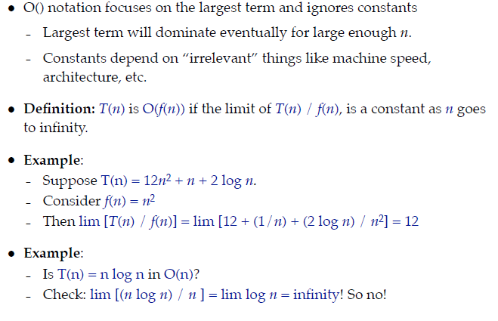
Big Oh Notation

Slide 47
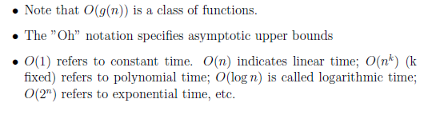
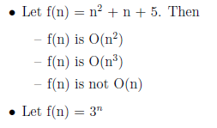
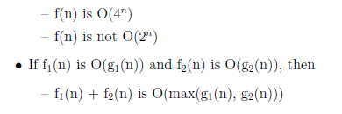
Examples

Slide 48
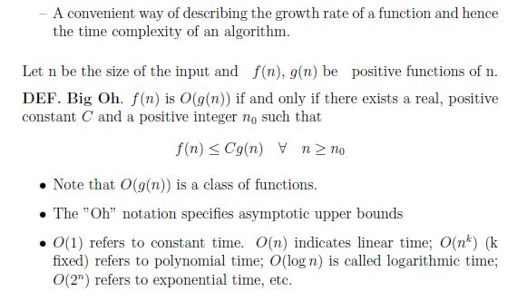
Big Oh: Alternative Definition

Slide 49
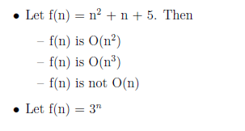
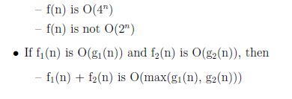
Examples

Slide 50
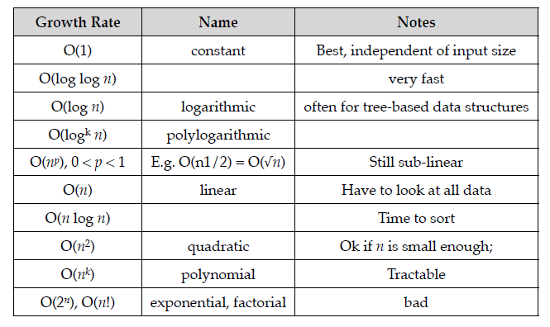
Big Oh Taxonomy

Slide 51
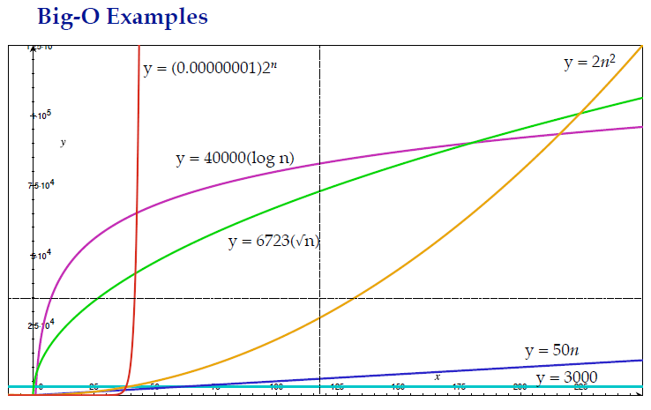

Slide 53
10^9 instructions per second

Slide 54
Role of Constants
Constant C that appears in the definition of the asymptotic upper bounds is very important.
Depends on the algorithm, machine, compiler,
big ”Oh” notation gives only asymptotic complexity.
As such, a polynomial time algorithm with a large value of the constant may turn out to be much less efficient than an exponential time algorithm (with a small constant) for the range of interest of the input values.

Slide 55

Faster Computer Vs Better Algorithm
Algorithmic improvement more useful than hardware improvement.

Slide 56
Worst Case Running Time
Worst case Running Time of an algorithm is an upper bound on the running time for any input.
Knowing it gives us a guarantee that the algorithm will never take any longer. There is no need to make an educated guess about the running time.

Slide 57
Average case Running Time
The expected behavior when the input is randomly drawn from a given distribution.
The average-case running time of an algorithm is an estimate of the running time for an “average” input.
Computation of average-case running time entails knowing all possible input sequences, the probability distribution of occurrence of these sequences, and the running times for the individual sequences.
Often it is assumed that all inputs of a given size are equally likely.

Slide 58
Amortized Running Time
The time required to perform a sequence of (related) operations is averaged over all the operations performed.
Amortized analysis can be used to show that the average cost of an operation is small, if one averages over a sequence of operations, even though a simple operation might be expensive.
Amortized analysis guarantees the average performance of each operation in the worst case.

Slide 59
Some Examples
1. Finding the minimum element in a list of elements.
Worst case = O(n)
Average case = O(n)
2. Quick sort
Worst case = O(n2)
Average case = O(n log n)
3. Merge Sort, Heap Sort
Worst case = O(n log n)
Average case = O(n log n)
4. Bubble sort
Worst case = O(n2)
Average case = O(n2)
5. Binary Search Tree: Search for an element
Worst case = O(n)
Average case = O(log n)

Slide 60
Binary Search Tree
BST property: all elements stored in the left subtree of any node x are less than the element stored at x and all elements stored in the right subtree of x are greater than the element at x.

Slide 61
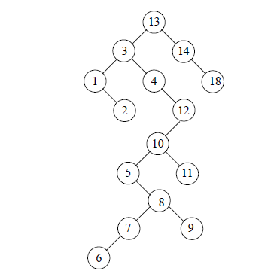
13, 3, 4, 12, 14, 10, 5, 1, 8, 2, 7, 9, 11, 6, 18

Slide 62
Worst case
If we repeatedly insert a sorted sequence of values to form a BST, we obtain a completely skewed BST. The height of such a tree is n−1 if the tree has n nodes. Thus, the worst case complexity of searching or inserting an element into a BST having n nodes is O(n).

Slide 63
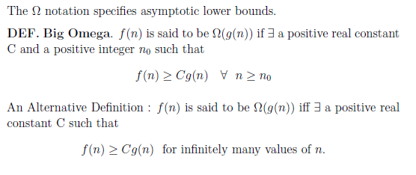
Big Omega
f(n) = Ω (g(n)

Slide 64
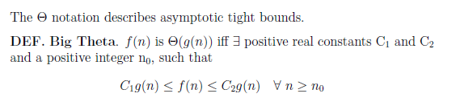
Big Theta Notations

Slide 65
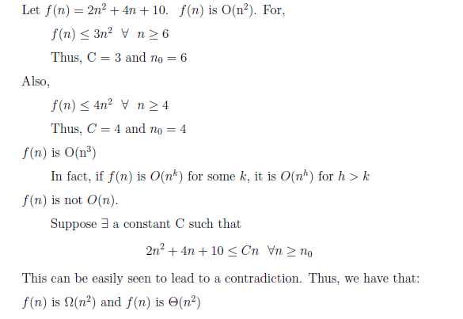
Examples

Slide 66
Little Oh …
For every constant c there should exist some n0 such that
f(n) < c(g(n)), n > n0
f(n) < c(g(n)), n > n0
How is it different from Big-oh (there exist c and no)?
Here it is for every c there should exist a n0

Slide 67
Asymptotic Notation
F(n) = O(g(n)) -- f < g
F(n) = Ω (g(n)) -- f > g
F(n) = Θ (g(n)) -- f =g
F(n) = o(g(n)) -- f < g
F(n) = ω(g(n)) -- f > g
Notation (Abuse): F(n) = O(g(n) →
f(n) ε (O(g(n))

Slide 68
Some Uses Of Performance Analysis
determine practicality of algorithm
predict run time on large instance
compare 2 algorithms that have different asymptotic complexity
e.g., O(n) and O(n²)
Notes:
If the complexity is O(n²), we may consider the algorithm practical even for large n.
An O(2^{n}) algorithm is practical only for small n, say n < 40.
The worst-case run time of an O(n²) algorithm will quadruple with each doubling of n. So if the worst-case time is 10 sec when n = 100, it will be approximately 40 sec when n = 200.

Slide 69
Limitations of Analysis
Doesn’t account for constant factors.
but constant factor may dominate
1000n vs n²
and we are interested only in
n < 1000

Slide 70
Limitations of Analysis
Modern computers have a hierarchical memory organization with different access time for memory at different levels of the hierarchy.

Slide 71
Memory Hierarchy
MAIN
L2
L1
ALU
R
8-32
32KB
512KB
512MB
1C
2C
10C
100C
Notes:
1 cycle to add data that are in the registers
2 cycles to copy data from L1 cache to a register
10 cycles to copy from L2 to L1 and register

Slide 72
Limitations of Analysis
Our analysis doesn’t account for this difference in memory access times.
Programs that do more work may take less time than those that do less work.
A program that does 100 operations on the same data would take less time
than (would make one fetch at a cost of 100 cycles and perform 100 operations at a cost
of 1 cycle each for a total of 200 cycles)
A program that performs a single operation on say 50 different pieces of data
that each time data is fetched from main memory, only one piece of data is fetched.
would need 50 * 100 cycles just to fetch the data.
Notes:
A program that does 100 operations on the same data would take less time than
A program that performs a single operation on say 50 different pieces of data
(assuming, in a simple model) that each time data is fetched from main memory, only one piece of data is fetched. The first program would make one fetch at a cost of 100 cycles and perform 100 operations at a cost of 1 cycle each for a total of 200 cycles. The second program would need 50 * 100 cycles just to fetch the data.

Slide 73
Performance Need
Measure actual time on an actual computer.
What do we need? programming language
working program
computer
compiler and options to use
example: javac -o

Slide 74
Measuring actual time
Measurement of code execution is acceptable only when the elapsed time is large relative to the accuracy of the clock.
How to measure relative to Clock accuracy
say 100 milliseconds
Repeat work many times to bring total time to be >= 1 second

Slide 75
Performance Measurement Needs
data to use for measurement
worst-case data
best-case data
average-case data
timing mechanism --- clock

Slide 76
Issues to be kept in mind
Suppose we are measuring worst-case run time of “sorting”. The array “a” initially is in descending order.
After the first iteration, the data is sorted.
Subsequent iterations no longer start with worst-case data.
So the measured time is for one worst-case sort plus the no. of times the best-case sorts!

Slide 77
System Issues
Using System.currentTimeMillis() say in java, is a problem, because the program may run for only part of the physical time that has elapsed.
The UNIX command time gives the time for which your program ran.
Suppose the clock is updated every 100ms and “doSomething” takes 99ms and it takes another 1ms to do everything else in the loop.
If the clock is updated exactly at the start of the loop and it is not updated between the start and end (“the startTime = and elapsedTime += statements”) .
then elapsedTime is always 0.

Slide 78
Sorting Methods
Insertion Sort
Bubble Sort
Selection Sort
Count Sort
Shaker Sort
Shell Sort
Heap Sort
Merge Sort
Quick Sort

Slide 79
Complexity of merge sort
Mergesort is a divide and conquer algorithm.
mergesort calls itself recursively.

Slide 80
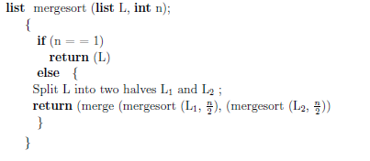
Merge Sort Complexity
A divide and conquer algorithm.
Calls itself recursively

Slide 81
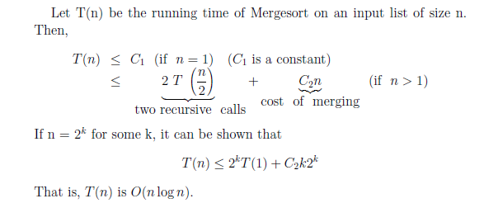

Slide 82
Asymptotic Timing Analysis
Merge Function
T(1) = c₀
time c₀ to execute when list length is 1 (we can also consider null list)
Consider lists of total length n. The recursive call is on lists of total length n−1, so we have
T(n) = T(n−1) + c₁
where c₁ is an constant upper bound on the time required to execute the if statement and

Slide 83
T(1) = c₀ T(2) = T(1) + c₁ = c₀ + c₁ T(3) = T(2) + c₁ = c₀ + 2c₁ T(4) = T(3) + c₁ = c₀ + 3c₁ ... T(n) = T(n−1) + c₁ = c₀ + (n−1)c₁ = (c₀ - c₁) + c₁n
By induction that for n >=0, T(n)=(c₀ - c₁)+ c₁n.
Thus, clearly O(n)

Slide 84
We know that any solution must work for arbitrary constants; so again we replace them both with 1 to keep things simple. That leaves us with the following recurrence equations to work with
T(1) = 1 T(n) = 2 T(n/2) + n
T(n) = 2T(n/2) + n = 2(2T(n/4) + n/2) + n = 4T(n/4) + n + n = 4(2T(n/8) + n/4) + n + n = 8T(n/8) + n + n + n = nT(n/n) + n + ... + n + n + n = n + n + ... + n + n + n → ( lg n + 1 n’s)
= n lg n
We observe that
n lg n + n < n lg n + n lg n = 2n lg n for n>0, so the running time is O(n lg n).

Slide 85
Proof by Strong Induction
For arbitrary n, assuming the induction hypothesis T(m) = m lg m + m for all m<n.
Case n = 0: vacuously true
Case n = 1: T(1) = 1 = 1 lg 1 + 1
Case n > 1:
Induction Hypothesis:
Proof:
T(n) = 2 T(n/2) + n
= (n/2) lg (n/2) + 2(n/2) + n (by induction hypothesis)
= n lg (n/2) + 2n
= n lg n − 1) 1) + 2n
= n lg n + n
Since n lg n + n is O(n lg n), we have shown that merge sort is O(n lg n)

Slide 86
Computing Fibanacci Numbers
Fibonacci numbers are defined recursively:
F₀ = 0
F₁ = 1
F_{i} = F_{i-1} ⁺ F_{i-2} for i > 1.
How to code it?

Slide 87
Computing Fibanacci Numbers
Fibonacci numbers are defined recursively:
F₀ = 0
F₁ = 1
F_{i} = F_{i-1} ⁺ F_{i-2} for i > 1.
As a recursive algorithm (first attempt):
Algorithm BinaryFib(k):
Input: Nonnegative integer k
Output: The kth Fibonacci number F_{k}
if k = 1 then
return k
else
return BinaryFib(k - 1) + BinaryFib(k - 2)

Slide 88
Analyzing the Binary Recursion Fibonacci Algorithm
Let n_{k} denote number of recursive calls made by BinaryFib(k). Then
n₀ = 1
n₁ = 1
n₂ = n₁ + n₀ + 1 = 1 + 1 + 1 = 3
n₃ = n₂ + n₁ + 1 = 3 + 1 + 1 = 5
n₄ = n₃ + n₂ + 1 = 5 + 3 + 1 = 9
n₅ = n₄ + n₃ + 1 = 9 + 5 + 1 = 15
n₆ = n₅ + n₄ + 1 = 15 + 9 + 1 = 25
n₇ = n₆ + n₅ + 1 = 25 + 15 + 1 = 41
n₈ = n₇ + n₆ + 1 = 41 + 25 + 1 = 67.
Note that the value at least doubles for every other value of n_{k}. That is, n_{k} > 2^{k/2}. It is exponential!

Slide 89
Fibonaci- Dynamic programming (slow)
It should be clear that if we’ve already computed F(k−2) and F(k−1), then we can add them to get F(k).
Next, we add F(k−1) and F(k) to get F(k+1).
We repeat until we reach k=n.
.This algorithm takes O(1) space and O(n)operations.

Slide 90


Matrix Exponentiation
It is important to use exponentiation by squaring with this algorithm,
because otherwise it degenerates into the dynamic programming algorithm.
This algorithm takes O(1) space and O(logn) operations.
(Note: This is counted in terms of the number of bigint arithmetic operations,
not primitive fixed-width operations.)

Slide 91
def LinearFibonacci(n):
curr, next = 1, 1
for x in xrange(2, n):
next, curr = ((next+curr),next)
return next

Slide 92
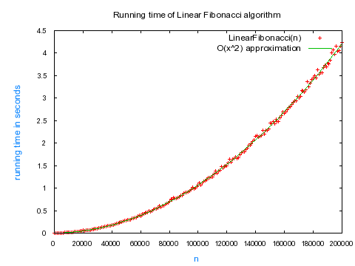

Slide 93
Does not look Linear?
Theoretical analysis assumed that all the operations in the algorithm executed in constant time.
But this is not the case when we run the algorithm on a real machine!
As the Fibonacci numbers get larger, each addition runs in time proportional to the length of the previous Fibonacci number.
It's because these huge numbers no longer fit in the basic units of computation in the CPU; so a big integer library is required.
The addition of two numbers of length O(n) in a big integer library takes time of O(n).

Slide 94
Practice Exercise
Learn measuring execution time of a program to the precision you want.
Understand recursion so that like in the Fib, case, you can switch to an efficient program

Slide 95
Exercises
1. Given two non-empty integer circular arrays of the same length, write a program to determine whether they are equal.
2. In an array containing n elements, a majority value is any value that occurs more than N div 2 times. Given that there is one, determine the majority value in a given array. A linear solution is desired

Slide 96
Exercises (Contd)
3. Rotate a one Dimensional array of N elements by I positions. For instance, with N= 8 and I =4, the vector ABCDEFGH is rotated by EFGHABCD. Naïve program, uses an N element vector to do the job in steps. Can you rotate the vector in time proportional to N using only a few extra words of storage.
4. Given a dictionary of English words, find all the sets of anagrams. For instance, “pots”, “stop”, and “tops” are all anagrams of one another because each can be formed by permuting the letters of the other.

Slide 97
Exercises (Contd)
Given two integer arrays, P, Q (0..N-1). The arrays are such that
P(i) >= 0, Q(i) >0 for all I
P(0) + … + P(N-1) = Q(o) + … + Q (N-1)
Along a circular race course are N pits, clockwise numbered from 0 through N-1. The amount of petrol present at pit, i, equals P(i), whereas the petrol required to reach from pit,i, the clockwise next pit equals Q(i).
Write a program to determine all pits from which a car, with an initially empty and sufficiently large tank, can complete the whole course in the clockwise direction.

